Slide 1
Cancer Detection
Team members:​
Savannah (Yuxuan) Sun; Jackey (Kai) Jia; Andy (Jiaze) Ma; Marvin Larweh
10/15/2024

Slide 2
Content
Objective
Current State & Limitations
Innovation
Impact
Risks
Cost
Timeline
Evaluations / Checkpoints

Slide 3
Objective - What are we trying to do?
Goal: Early-stage cancer detection
Challenge: Identifying key biomarkers in complex blood samples
Current Issue: Machine learning struggles with variable relevance
Solution: Develop ML tool to detect most relevant biomarkers

Slide 4
Current State & Limitations
Existing ML models: SVM, Random Forest, etc.
• Challenges:
• Limited labeled data → data bias (overfitting/underfitting)
• Inflexibility across different datasets
• No universal biomarkers identified
• High financial costs

Slide 5
Innovation - What’s new, and why will it succeed?
MIGHT (Multidimensional-Informed Generalized Hypothesis Technology)
Core Technique: Decision trees & forests
Strengths:
Universal applicability across datasets, variables, and outcomes
Optimizes dataset for specific biomedical outcomes (e.g., cancer types)
Flexible for early-stage cancer detection across diverse types
Why it will succeed:
High adaptability → broader potential applications
Efficient parameter selection → improved accuracy in early detection

Slide 6
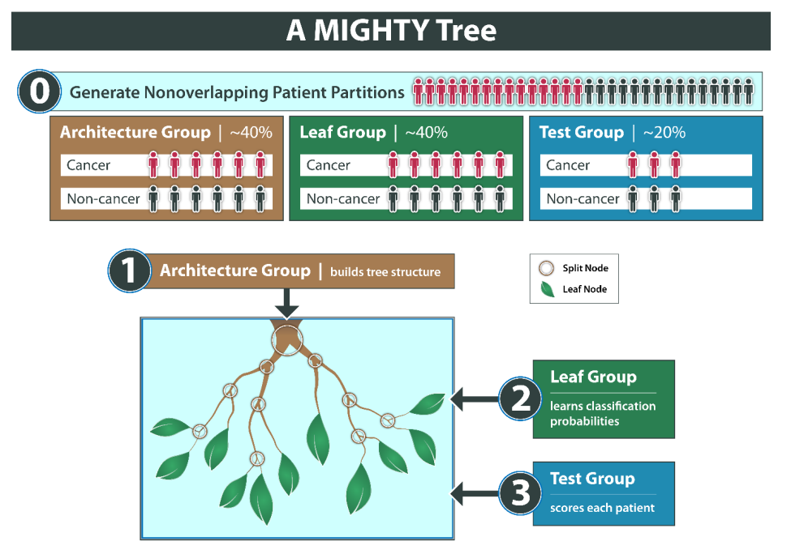
Innovation - What’s new, and why will it succeed?
Improve the MIGHT model
Efficiency
Accuracy

Slide 7
Innovation - What’s new, and why will it succeed?
Pruning & Parallelization
Use pruning to remove unnecessary branches
Apply parallel processing
Hyperparameter Tuning
Limit tree depth to balance between overfitting and underfitting.
Increase minimum samples per leaf to avoid over-segmentation.
Enhanced Forest Algorithm
Use Boosting techniques (e.g., XGBoost, LightGBM) to reduce errors and improve accuracy.
Experiment with reducing the number of trees to increase training speed.
Notes:
Pruning & Parallelization
Use pruning to remove unnecessary branches, reducing model complexity and improving generalization.
Apply parallel processing
Hyperparameter Tuning
Limit tree depth to balance between overfitting and underfitting.
Increase minimum samples per leaf to avoid over-segmentation.
Enhanced Forest Algorithm
Use Boosting techniques (e.g., XGBoost, LightGBM) to reduce errors and improve accuracy.
Experiment with reducing the number of trees to increase training speed.

Slide 8
Impact - Who benefits, and what’s the potential impact?
Target Audience:
Physicians: Access to a robust tool for early cancer risk assessment
Patients: Increased survival rates through early detection
Example - Breast cancer 5-year survival rates (U.S., 2012-2018):
Stage 0: Nearly 100%
Stage I: Close to 99%
Stage II: About 93%
Stage III: Approximately 72%
Stage IV: Around 28%
Impact:
Prevent ~1 million late-stage diagnoses annually, saving lives

Slide 9
Risks - What are the major risks?
Prediction Error:
ML models prone to error → potential misdiagnosis
Minimizing error will be our key focus
Data Quality:
Poor data → biased results
Importance of careful dataset selection and validation

Slide 10
Cost - How much will it cost?
Time
About 10 hours per week for development and testing
Computing Power
About 300 hours of processing time
Labor
4 members of out team

Slide 11
Timeline - How long will it take?
Total Duration: Two semesters (~9 months)
Detailed Timeline:
Sprint 0: (08/27/2024 – 09/12/2024): Write project proposal & establish ML baseline
Sprint 1: (09/13/2024 – 10/17/2024): Replicate demo tests with different metrics
Sprint 2 (Mid-term): (10/21/2024 – 12/12/2024): Profile the code, identify slow functions
Sprint 3: (01/06/2025 – 02/04/2025): Improve the MIGHT algorithm
Sprint 4: (02/05/2025 – 03/03/2025): Implement improvements, test results
Sprint 5: (03/04/2025 – 04/07/2025): Achieve 10% efficiency improvement
Sprint 6 (Final): (04/08/2025 – 05/10/2025): Achieve 20% efficiency, submit final project
Done!

Slide 12
Evaluation - How will we measure success?
Midterm Success Check:
Sprint 2 (10/21/2024 – 12/12/2024): Code profiling report
Goal: Identify slowest functions, potential improvements
Key Deliverable: Report on inefficiencies & improvement plans
Final Success Check:
Sprint 6 (04/08/2025 – 05/10/2025): Final improvements (20% efficiency)
Goal: Compare results to baseline (accuracy & speed)
Key Deliverable: Final report on improvements, code, and visualization

Slide 13
References
[1] - Elemento, O., Leslie, C., Lundin, J., & Tourassi, G. (2021). Artificial Intelligence in cancer research, diagnosis and therapy. Nature Reviews Cancer, 21(12), 747–752. https://doi.org/10.1038/s41568-021-00399-1
[2] - Curtis, S. D. (2024). Detecting and Combining Useful Sets of Predictive Variables.
[3] - NCI. (2024, May 9). Cancer statistics. https://www.cancer.gov/about-cancer/understanding/statistics
[4] - Campbell, D. (2014, September 21). Almost half of cancer patients diagnosed too late. The Guardian. https://www.theguardian.com/society/2014/sep/22/cancer-late-diagnosis-half-patients
[5] - American Cancer Society (ACS) and National Cancer Institute (NCI) regularly publish survival rate data based on extensive patient data and clinical research.

Slide 14
Thanks for watching!

